Slide 1

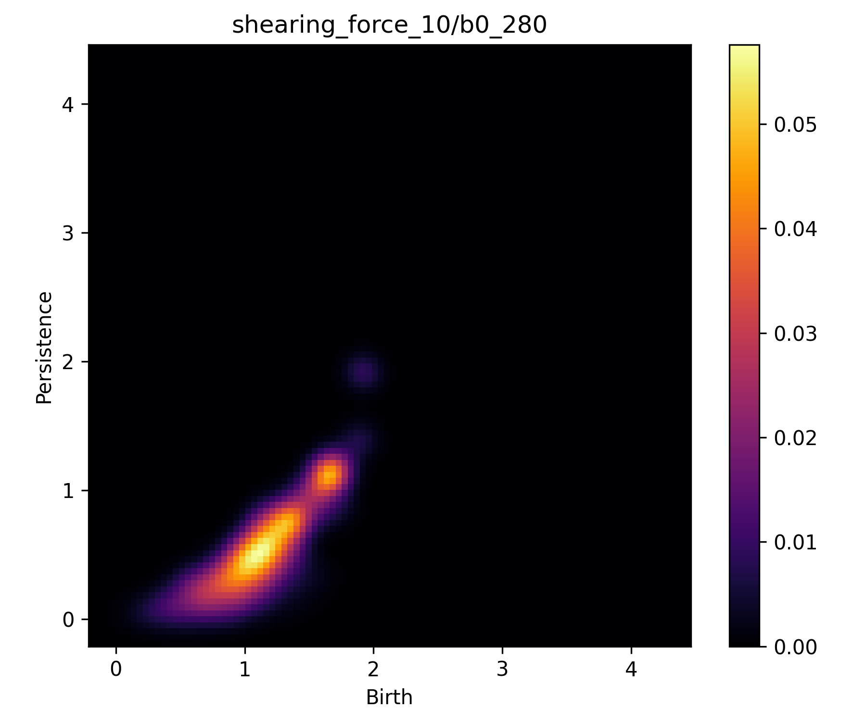
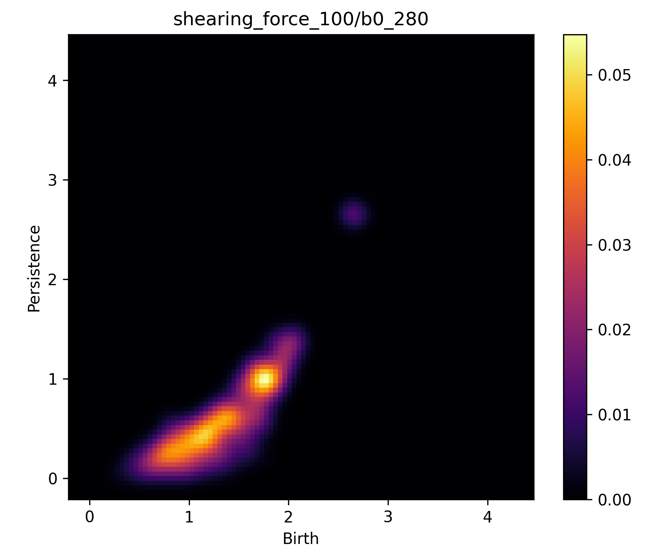
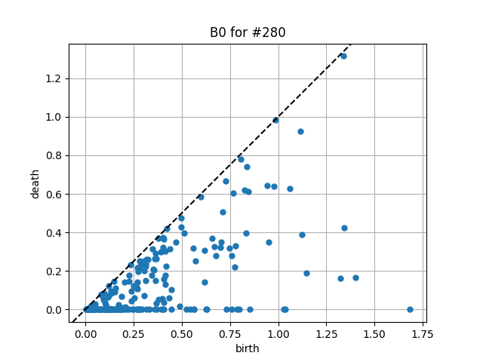
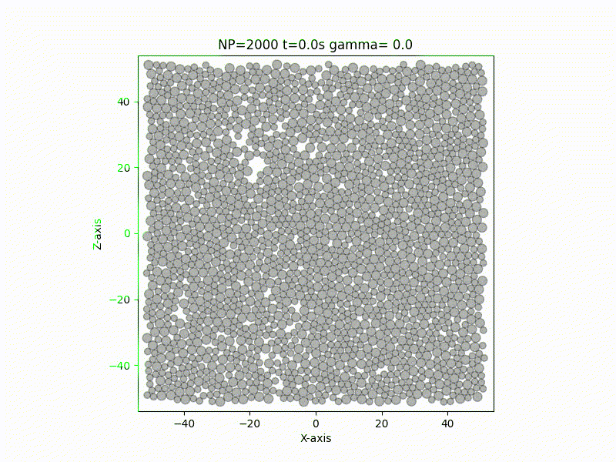
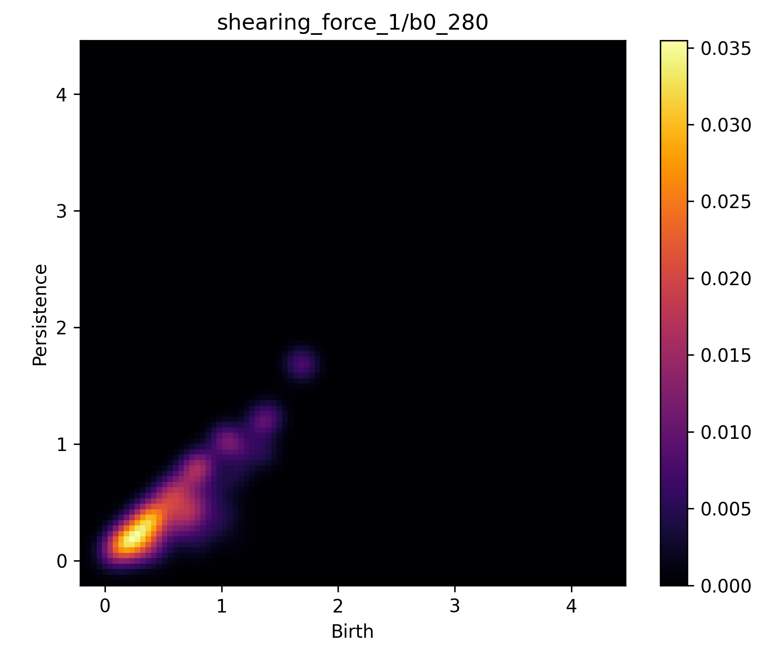
Dense Suspensions: What can AI tell us about Oobleck?
Ismaeel Malek, Catherin Lalu, Linda Cummings, Jonathan Jaquette, Lou Kondic
Department of Mathematical Sciences, New Jersey Institute of Technology
Funded by the Grace Hopper AI Research Fund
Dense suspensions (fluids with a high percentage of solid particles within them, like Oobleck) exhibit behaviors like shear thickening (an increase in viscosity under stress) which are difficult to predict through conventional fluid-dynamic means.
The model that we trained uses topological information (connected components) about a snapshot of a particular dense suspension simulation. Persistence diagrams encode such topological information about the network of forces between particles at that particular point in time. Numerically, they exist as a set of ordered pairs whose length differs even between diagrams made from different snapshots of the same simulation.
Using this method to train a model to predict the applied stress, we found that the model was accurate when the range of applied stresses in the training data was low (1-10), but the models failed with higher ranges (1-100)
Our goal was to train a machine learning model to predict certain properties of dense suspensions. We did this by generating many fluid simulations of dense suspensions, and training the model on the data from some while testing it using others.
Although the cases where this method is successful are promising, we believe that small adjustments must be made in order to further the range for which it makes accurate predictions. Our current plan includes making changes to the mode by which our images are generated.
Since persistence diagrams are unsuitable as input for machine learning, we convert them to persistence images through a smoothing process which also vectorizes the data, so it always has an identical number of elements.
We hope that this approach of using topological data analysis in our machine learning pursuits will allow us to make very strong advances in the fluid dynamics of dense suspensions, which has resisted solutions through traditional means for many years.
Although we were interested in models that could predict any number of properties of the dense suspension (packing fraction, viscosity, etc), the particular property we decided to train this model for was shearing stress, which is the amount of stress that the dense suspension was placed under.

